Slide 1

Software Engineering and VR
The Devil in the Details
Tom Forsyth
Software Architect, Oculus
Jan 27th 2015

Slide 2
Tom Forsyth
Graphics drivers @ 3Dlabs
Game graphics @ Muckyfoot
Urban Chaos
Startopia
Blade 2
Animation middleware: Granny3D @ RAD Game Tools
Instruction set design on Larrabee / Xeon Phi @ intel
VR @ Valve
VR support on Team Fortress 2 & Half Life 2
Software Architect @ Oculus
All things graphics
Distortion & calibration, interacts with lens design
Best practices, dev.rel. support, psychology

Slide 3
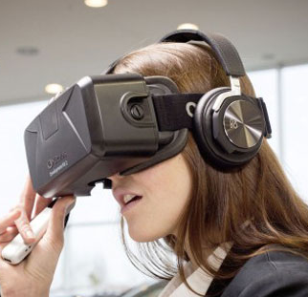
VR is awesome!

Slide 4
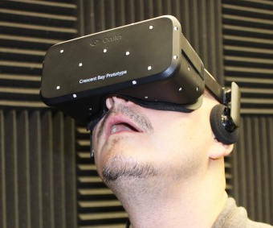
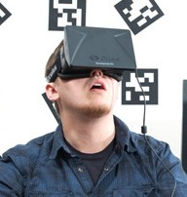
VR is awesome!

Slide 5
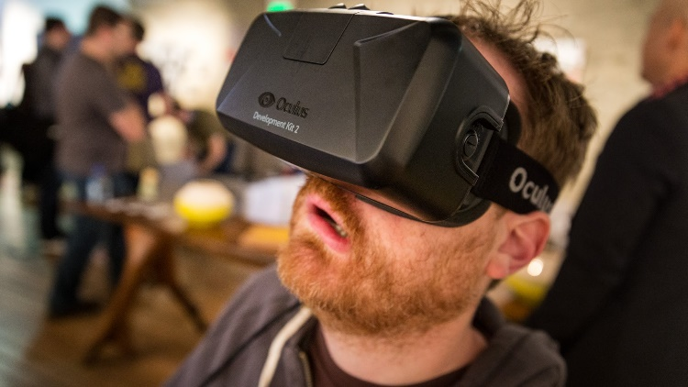
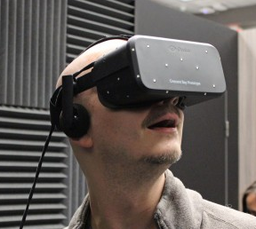
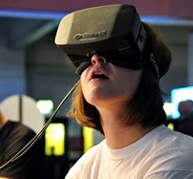
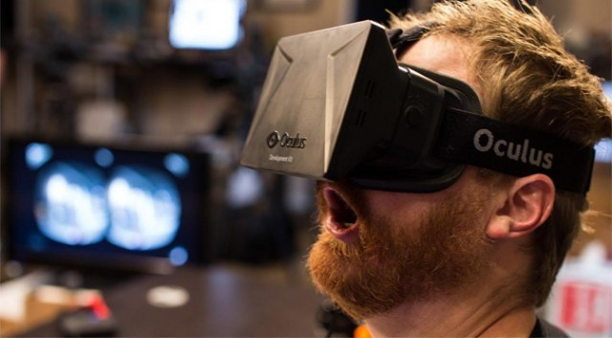
VR is awesome!

Slide 6

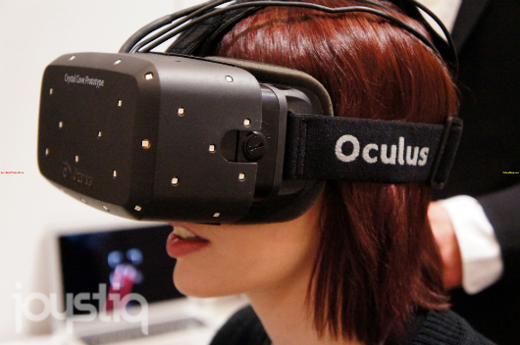
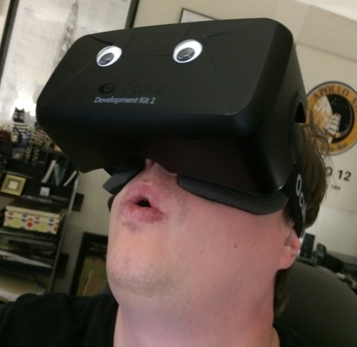
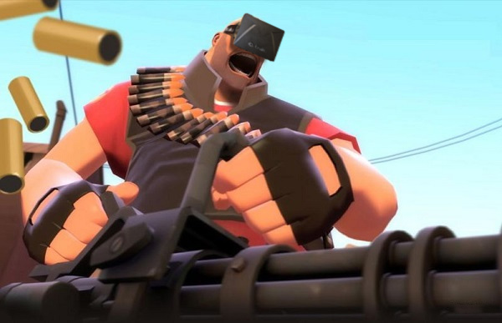
VR is awesome!

Slide 7
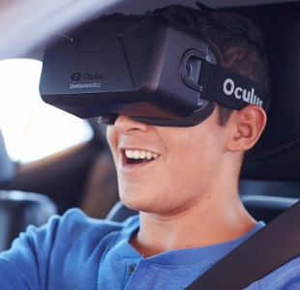

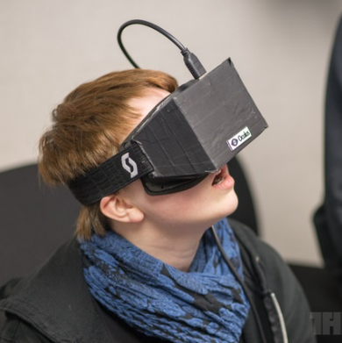
VR is awesome!

Slide 8
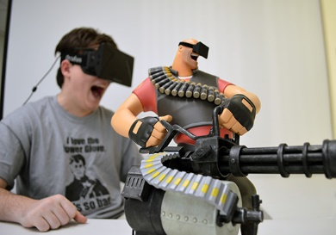

VR is awesome!

Slide 9
VR is awesome!
VR is also incredibly tricky

Slide 10
VR is awesome!
VR is also incredibly tricky
“Bleeding-edge realtime 3D graphics” is the easy bit
Lots of hard stuff here of course, but needs an entire lecture series

Slide 11
VR is awesome!
VR is also incredibly tricky
“Bleeding-edge realtime 3D graphics” is the easy bit
Lots of hard stuff here of course, but needs an entire lecture series
VR adds so many other areas
Display and optics
Hardware diversity
Time and latency
Bugs that take a long time to manifest
Interactions with user physiology
3

Slide 12
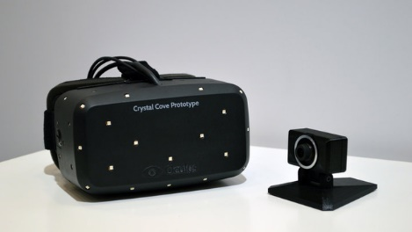
VR overview
Hardware:
Screen
Lenses
IMU (gyro + accelerometer)
Camera & LEDs
(and lots of scary details!)
4

Slide 13
VR overview
Software:
Tracking
Prediction
Rendering
Timewarp
Distortion & processing
(all timings are examples, not any specific device)

Slide 14
Software in detail
Read 60Hz camera
Find LED dots
Find HMD pose from dot positions

Slide 15

Software in detail
Read 60Hz camera
Find LED dots
Find HMD pose from dot positions
Read 1000Hz IMU: gyro + accel
Sensor fusion
Last known-good camera pose
Integrate IMU data forwards
(this is the concept - in practice it’s a continuous filter)

Slide 16
Software in detail
20ms
Read 60Hz camera
Find LED dots
Find HMD pose from dot positions
Read 1000Hz IMU: gyro + accel
Sensor fusion
Last known-good camera pose
Integrate IMU data forwards
(this is the concept - in practice it’s a continuous filter)
Predict motion forwards to next frame display time
Will typically be ~20ms away
6

Slide 17
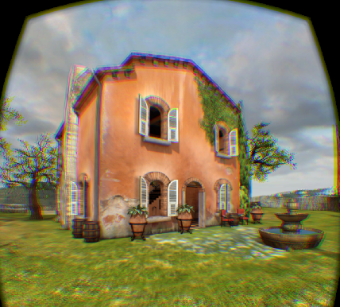
Software in detail
20ms
App renders view from each eye
Typically takes a frame, i.e. 10-15ms

Slide 18
Software in detail
20ms
App renders view from each eye
Typically takes a frame, i.e. 10-15ms
Re-read latest IMU data and re-predict to next frame
Prediction is now only ~5ms
Timewarp
5ms

Slide 19

Software in detail
20ms
App renders view from each eye
Typically takes a frame, i.e. 10-15ms
Re-read latest IMU data and re-predict to next frame
Prediction is now only ~5ms
Timewarp
Image processing
Distortion
Chromatic aberration
Compositing
Gamma curve
Overdrive
5ms
7

Slide 20
Doing the timewarp
Reprojection of a rendered scene to a different orientation
Rotational works well, positional less so
Three separate effects in one mechanism

Slide 21
Doing the timewarp
Reprojection of a rendered scene to a different orientation
Rotational works well, positional less so
Three separate effects in one mechanism
Late IMU read, re-predict, and fixup
Smaller prediction time = much less error

Slide 22
Doing the timewarp
Reprojection of a rendered scene to a different orientation
Rotational works well, positional less so
Three separate effects in one mechanism
Late IMU read, re-predict, and fixup
Smaller prediction time = much less error
Rolling shutter compensation
The display lights up a line at a time, not all at once

Slide 23
Doing the timewarp
Reprojection of a rendered scene to a different orientation
Rotational works well, positional less so
Three separate effects in one mechanism
Late IMU read, re-predict, and fixup
Smaller prediction time = much less error
Rolling shutter compensation
The display lights up a line at a time, not all at once
Mitigation for stutters and stalls (“async timewarp”)
Makes them less painful, but still look bad
This does NOT mean you can render at 30fps!
9

Slide 24
Sounds simple, what could go wrong?
VR brings some specific problems to the picture
Timing is critical
VR relies on correct prediction
Errors in timing are difficult to diagnose
Hardware configuration & variability
GPUs
Power management
USB devices
Human variation
11

Slide 25
Timing, timing, timing
Rendering uses a lot of predicted HMD poses
Requires high-quality data to do good prediction
Requires the actual display time to be within ~2ms of predicted
Being an entire frame late or early (~12ms) is throw-against-wall bad

Slide 26
Timing, timing, timing
Rendering uses a lot of predicted HMD poses
Requires high-quality data to do good prediction
Requires the actual display time to be within ~2ms of predicted
Being an entire frame late or early (~12ms) is throw-against-wall bad
Incorrect timing is very difficult to see
Even experienced people can’t reliably see <10ms errors
But they will make people nauseous after 15mins
“Works on my machine” isn’t even reliable!
Most automated testing only does functionality, not timing
12

Slide 27
Hardware configuration problems - GPUs
VR requires a fixed, consistent framerate
Apps do not have fixed frame content
Timewarp can help mitigate the worst stutters

Slide 28
Hardware configuration problems - GPUs
VR requires a fixed, consistent framerate
Apps do not have fixed frame content
Timewarp can help mitigate the worst stutters
Massive range of performance in desktop PCs
Multiple axes of perf: drawcalls vs compute vs bandwidth
Any can be the limit for different parts of the scene

Slide 29
Hardware configuration problems - GPUs
VR requires a fixed, consistent framerate
Apps do not have fixed frame content
Timewarp can help mitigate the worst stutters
Massive range of performance in desktop PCs
Multiple axes of perf: drawcalls vs compute vs bandwidth
Any can be the limit for different parts of the scene
GPU APIs & system optimized for throughput, not low latency
Rendering pipeline has very low-quality timing feedback
Use big hammers to solve – lots of stalls & syncs
Wastes a lot of performance
17

Slide 30
Hardware configuration problems - Clocks
CPU and GPU will throttle/overclock according to thermals
Precise CPU clock measures cycles – changes with frequency!
Reliable “chipset” clock has coarse granularity
We use one to sync the other - mostly works
Finally fixed with Skylake CPUs – reliable AND precise
But Skylake isn’t out yet…
Especially difficult on mobile & laptops
Very aggressive throttling
Perf will change mid-frame
16

Slide 31
Hardware configuration problems - USB
Data collected by CPU polling
Hubs have unknown buffering granularity
Every PC has multiple hubs in it, plus external ones
Each adds unpredictable latency
USB devices can block each other (async isn’t that async)
HMD has a reliable clock, timestamps all events
But we still have to sync up HMD and CPU clocks over USB
18

Slide 32
Bug-fighting tools
Capture and reply of sensors
Robots & mo-cap
Motion-to-pixel tests
Feedback from HMD

Slide 33
Capture and replay of sensor inputs
Outputs compared with known-good results
Good for sensor algorithm development
Blob finding
Pose estimation
Fusion of IMU and vision
Good for nightly tests
Easy to accidentally add noise, off-by-one-sample errors during dev
Good for performance tests
Completely repeatable inputs
20

Slide 34
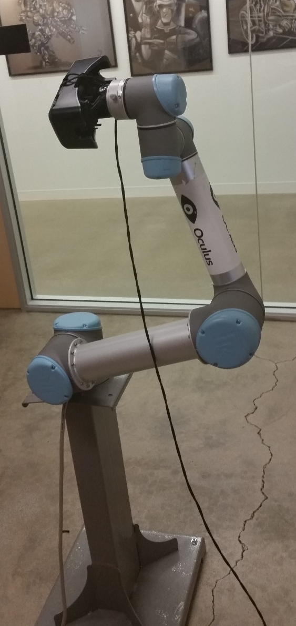
Robots & mo-cap
Robot arm with HMD mounted on it
Makes known & somewhat repeatable motions
Tests hardware sensor error, noise, temperature, etc
Cube/room of professional mo-cap cameras
Captures actual human movement
Data is not as clean as you’d like – lots of filtering needed
Hard to run nightly or regression tests
Slightly different every run
Changing HMD or camera requires recalibration
But we’re starting to try it
22

Slide 35
Motion-to-pixel tests
Feed sensor-fusion outputs to rendering engine
Optional deterministic time stream
Replace real clock with recorded one
Render & take screen captures

Slide 36
Motion-to-pixel tests
Feed sensor-fusion outputs to rendering engine
Optional deterministic time stream
Replace real clock with recorded one
Render & take screen captures
Comparing images is surprisingly difficult
“No change” optimisations can easily cause small pixel/colour changes
But are they correct changes or bugs? Requires operator skill
Differences between GPUs, even between driver versions
Bug fixes & new features require humans to re-approve new images
Still setting this system up – results TBD
24

Slide 37
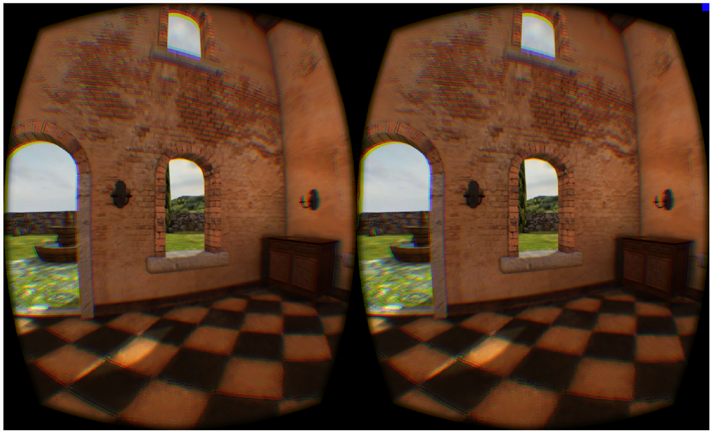
Feedback from HMD
HMD sends top-left pixel value back over USB, with timestamp
Top-left pixel is beyond lens range, so we can use as a frame ID
Dynamic end-to-end latency test of graphics system

Slide 38

Feedback from HMD
HMD sends top-left pixel value back over USB, with timestamp
Top-left pixel is beyond lens range, so we can use as a frame ID
Dynamic end-to-end latency test of graphics system

Slide 39
Feedback from HMD
HMD sends top-left pixel value back over USB, with timestamp
Top-left pixel is beyond lens range, so we can use as a frame ID
Dynamic end-to-end latency test of graphics system
Used to fine-tune prediction algos
Useful for helping a user set up a working system
Run simple Oculus test app, are you getting correct latency?
Spots dodgy drivers, broken cables, USB problems, etc

Slide 40
Feedback from HMD
HMD sends top-left pixel value back over USB, with timestamp
Top-left pixel is beyond lens range, so we can use as a frame ID
Dynamic end-to-end latency test of graphics system
Used to fine-tune prediction algos
Useful for helping a user set up a working system
Run simple Oculus test app, are you getting correct latency?
Spots dodgy drivers, broken cables, USB problems, etc
Not as useful to a running app
What can an app do with “latency is too high” message?
Dynamic scaling of rendering speed has difficult hysteresis & feedback
Still a hard research problem
26

Slide 41
Bug-fighting methodologies
Naming schemes
Code standards
Multiple pairs of eyes
Unit tests / test-driven development
Asserts
Code reviews

Slide 42
Naming schemes
Not that important, just pick one
CamelCaps vs under_scores
local/m_Member/g_Global
szHungarian

Slide 43
Naming schemes
Not that important, just pick one
CamelCaps vs under_scores
local/m_Member/g_Global
szHungarian
We chose:
CamelCaps
localVar/MemberVar/GlobalVar
no

Slide 44
Naming schemes
Not that important, just pick one
CamelCaps vs under_scores
local/m_Member/g_Global
szHungarian
Spaces and units – important!
EyePos -> EyePosInHead
Transform -> HeadFromWorld (see blog post for details)
Delta -> VsyncDeltaMillisecs
Brevity is not a virtue – take advantage of autocomplete!
We chose:
CamelCaps
localVar/MemberVar/GlobalVar
no
28

Slide 45
Code standards
In the sense of “which features of C++ do we use?”
Extremely effective

Slide 46
Code standards
In the sense of “which features of C++ do we use?”
Extremely effective… at causing arguments
Functional purists
Template metacoders
Inheritance-tree huggers
Abstractionistas
C99ers

Slide 47
Code standards
In the sense of “which features of C++ do we use?”
Extremely effective… at causing arguments
Functional purists
Template metacoders
Inheritance-tree huggers
Abstractionistas
C99ers
Conclusions fuzzy, but point towards using fewer language features
Sometimes called “C+” (many variants)
Fewer surprises, more typing
But coders are really good at typing
30

Slide 48
Multiple pairs of eyes
Bugs can be invisible to some, really obvious to others
Always get others to check your visuals
Learn what you can and can’t see

Slide 49
Multiple pairs of eyes
Bugs can be invisible to some, really obvious to others
Always get others to check your visuals
Learn what you can and can’t see
Ten people can’t see a problem and one person can – it’s a problem
There is no “authority” in these cases
Deal with it the same way as colour-blindness (5%-10% of the pop)
Designated guinea-pigs for each artifact

Slide 50
Multiple pairs of eyes
Bugs can be invisible to some, really obvious to others
Always get others to check your visuals
Learn what you can and can’t see
Ten people can’t see a problem and one person can – it’s a problem
There is no “authority” in these cases
Deal with it the same way as colour-blindness (5%-10% of the pop)
Designated guinea-pigs for each artifact
But sometimes you have to pick your battles
60Hz/75Hz/90Hz low-persistence
Fast-moving FPS games
Screen door effect vs blur
32

Slide 51
Unit tests / test-driven development

Slide 52
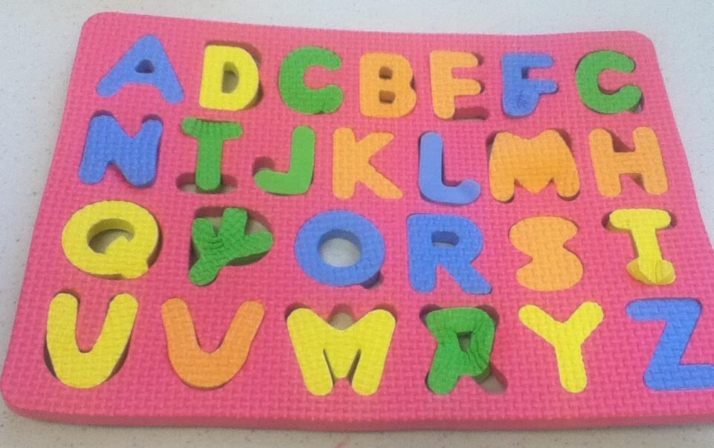
Unit tests / test-driven development
Analysing…

Slide 53
Unit tests / test-driven development
Analysing…
26/26 tests PASSED

Slide 54
Unit tests / test-driven development
Very little help in subjective algorithm development
Only work for refactoring and optimization
We just don’t do that very much! VR does not have “big data”
Not much use for GPUs
Actively impede algorithm development

Slide 55
Unit tests / test-driven development
Very little help in subjective algorithm development
Only work for refactoring and optimization
We just don’t do that very much! VR does not have “big data”
Not much use for GPUs
Actively impede algorithm development
I don’t like the bang for the buck
Very few interesting bugs would have been caught with them
Trivial ones easily caught by other methods
Not worth the effort, complexity and maintenance
34

Slide 56
Asserts
I love asserts
Personal codebase – 20% LOC are asserts!
Double as documentation
Cannot go out of date like comments and docs
Especially on function arguments/inputs – ranges, allowed combos, etc
Can be used for mini unit tests

Slide 57
Asserts
I love asserts
Personal codebase – 20% LOC are asserts!
Double as documentation
Cannot go out of date like comments and docs
Especially on function arguments/inputs – ranges, allowed combos, etc
Can be used for mini unit tests
Almost nobody dislikes asserts
Makes them almost unique amongst language features!
Though many aren’t very aggressive about using them
Lots of nasty bug-hunts could have been caught early by asserts
36

Slide 58
Code reviews
Cardboard-cutout-dog effect
Just explaining it to someone else causes self-analysis
Increases “bus factor”
Ownership = responsibility, not control. Tell people how your code works!
However, can be a time sink
Leads to yes-men review-buddies
Making it online, not in-person can help (but reduces CCD effect)
Hard-and-fast rules create cheats – make it recommended not mandatory
Various cultures within Facebook & Oculus
Different groups have different code review cultures
38

Slide 59
Bug-fighting methodologies – score sheet
Naming schemes
Code standards
Unit tests / TDD
Asserts
Code reviews
Pick one, almost any one
Keep it simple
Nope
Yes yes yes
Maybe, but don’t go nuts
39

Slide 60
…and that’s just the SDK!
Developing an app that uses VR has a bunch of other fun
All the usual complexity of realtime 3D rendering
Big performance requirements
Mono@60º@30fps -> Stereo@100º@75fps (and that was last year)
Input restrictions (can’t see a keyboard)
Design restrictions
Can’t force camera angles – must follow the user’s head
Cinematic language reduced – framing, composition, angles, cuts
For more, see my GDC2014 talk
41

Slide 61
VR is mean to brains
World scale is due to multiple cues
Pupil separation and head motion must match physical user
Or be a consistent scaling
Height of virtual camera from ground
Physical dimensions of in-game avatar
Vergence vs focus conflict
Floor-dragging effect – your feet overrule your eyes
Vestibular/optical mismatch – motion sickness
Ears say you’re sitting still, eyes say you’re moving
HW & SW working perfectly, but induces rollercoaster/travel/seasickness
43

Slide 62
VR is mean to coders
Multiple bugs can look identical, e.g. “judder” can be:
Framerate dropping below HMD rate
Incorrect latency prediction
Incorrect physics simulation time
Misbehaving USB hubs
GPU buffering/syncing (especially with multi-GPU)
Misc other rendering bugs
Errors frequently “invisible”, but still cause nausea
Extra frame of latency
Off-by-one-pixel rendering
Position tracking not working
Swapped eyes (yes, really)
45

Slide 63
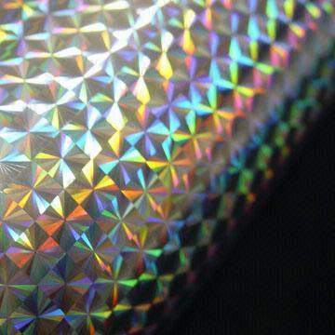
VR is really mean to graphics
Much of our graphics intuition becomes useless
Algorithms can be doing exactly what we want, yet feel terrible
Normalmaps look rubbish with stereo & head motion
Looks like “hologram foil”
Need high-quality, physically consistent disp.maps
Billboards and impostors have to be ~10x as far away
Grass, leaves, mist, effects
Most specular methods don’t stereo-fuse properly
…and specular that does fuse shows up surface triangle structure ☹
2D screenspace labels don’t work – need in-world 3D ones
47

Slide 64
Conclusion
VR is all the hard things rolled into one
Display and optics
Wide range of hardware
Time and latency
Bugs that take a long time to manifest
Interactions with user physiology

Slide 65

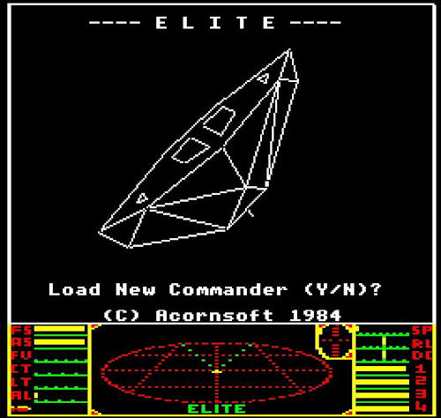
Conclusion
VR is all the hard things rolled into one
Display and optics
Wide range of hardware
Time and latency
Bugs that take a long time to manifest
Interactions with user physiology
But when it works it’s awesome
Dumpy: Going Elephants
Showdown demo by Epic
Elite:Dangerous with a DK2 and HOTAS
49

Slide 66

Questions?
developer.oculus.com
tom.forsyth@oculus.com
Further reading
Oculus dev area: Best Practices Guide
GDC / Connect 2014: Developing VR Experiences with the Oculus Rift
Personal blog: eelpi.gotdns.org/blog.wiki.html
Relevant entries: Matrix maths and names
Logging, asserts and unit tests

